Slide 1


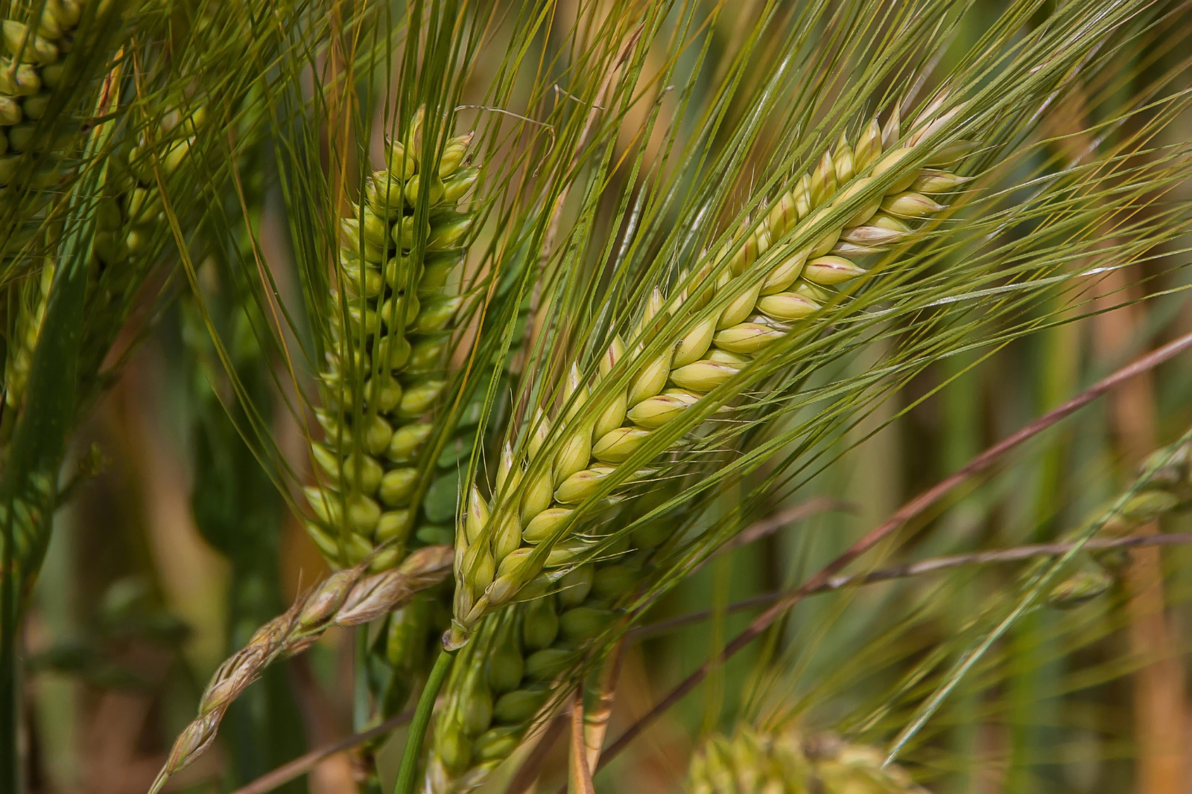

CROP PRODUCTION IN INDIA ANALYSIS
DIPEAN DASGUPTA
UMIP4841

Slide 2
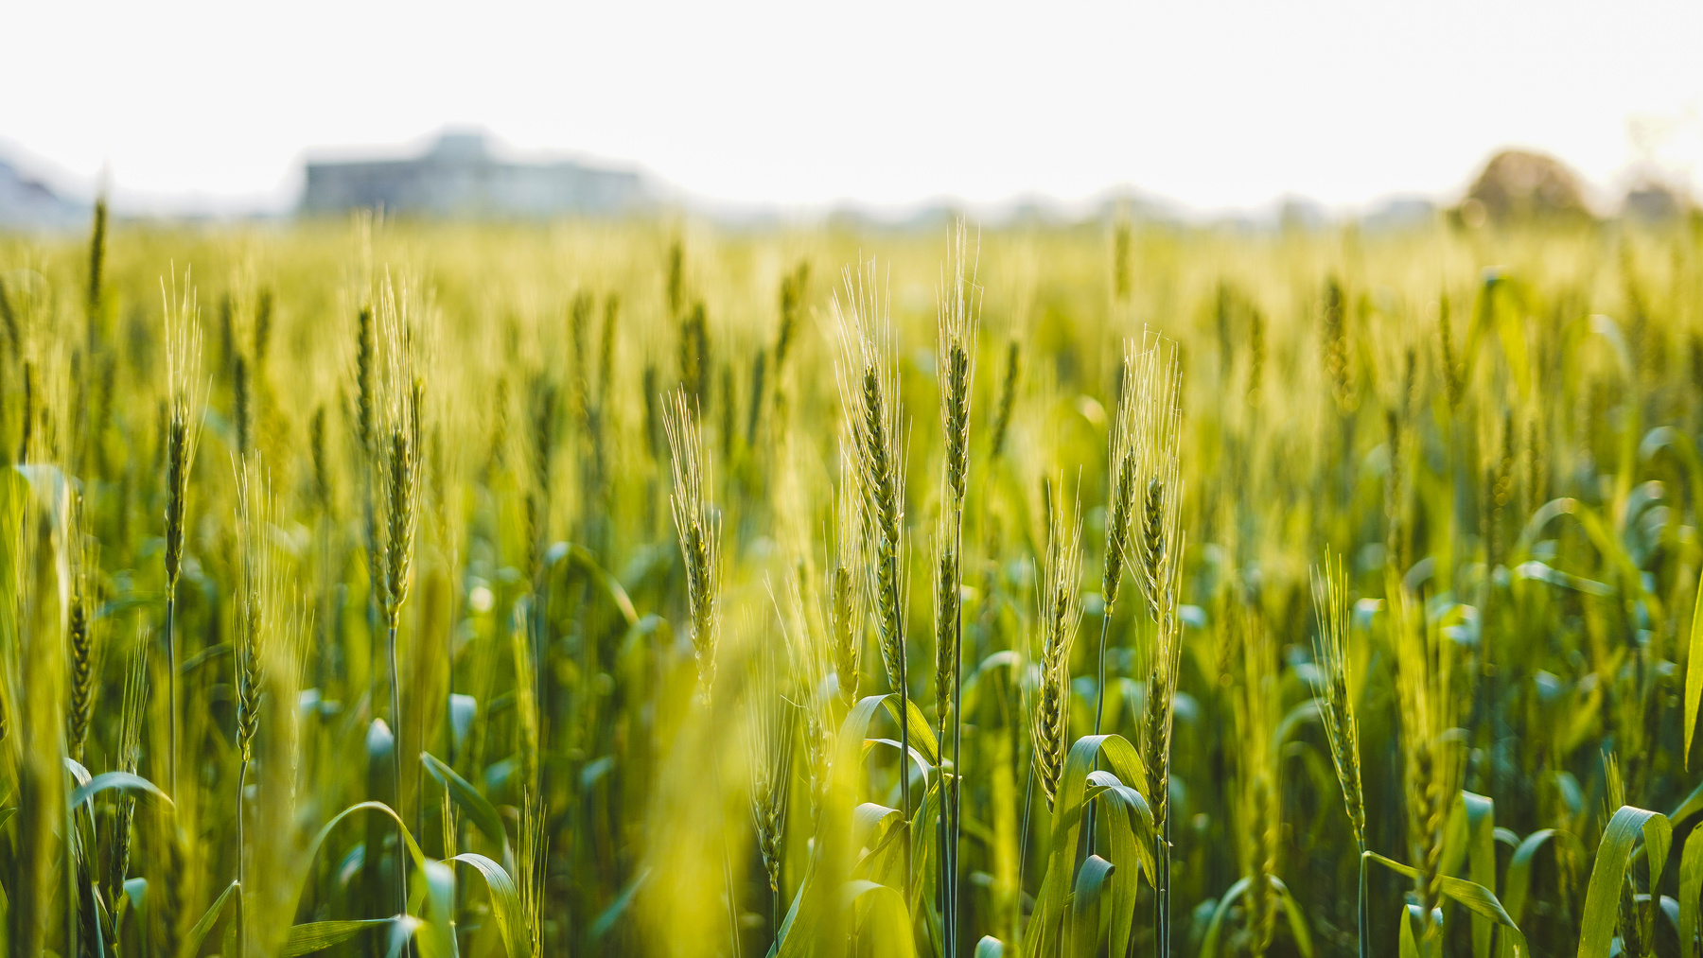
Content
01
Introduction
02
Problem
03
Data Overview
04
Analysis
05
Dashboard
06
Conclusion

Slide 3

Introduction
Crop production in India is a cornerstone of the nation's economy, sustaining the livelihoods of millions of farmers and contributing significantly to global agricultural markets. With diverse climatic conditions and fertile lands, India cultivates a wide array of crops, from staples like rice and wheat to cash crops such as cotton and sugarcane. The country is one of the world's largest producers of fruits, vegetables, and spices. Agricultural practices in India range from traditional methods to modern techniques, reflecting a blend of cultural heritage and innovation. This dynamic sector plays a crucial role in ensuring food security and supporting rural development across the country.

Slide 4

Problem Statement
The Agriculture business domain, as a vital part of the overall supply chain, is
expected to highly evolve in the upcoming years via the developments, which are taking place on the side of the Future Internet. This paper presents a novel
Business-to-Business collaboration platform from the agri-food sector perspective,which aims to facilitate the collaboration of numerous stakeholders belonging to associated business domains, in an effective and flexible manner.
This dataset provides a huge amount of information on crop production in India
ranging from several years. Based on the Information the ultimate goal would be to predict crop production and find important insights highlighting key indicators and metrics that influence crop production.

Slide 5

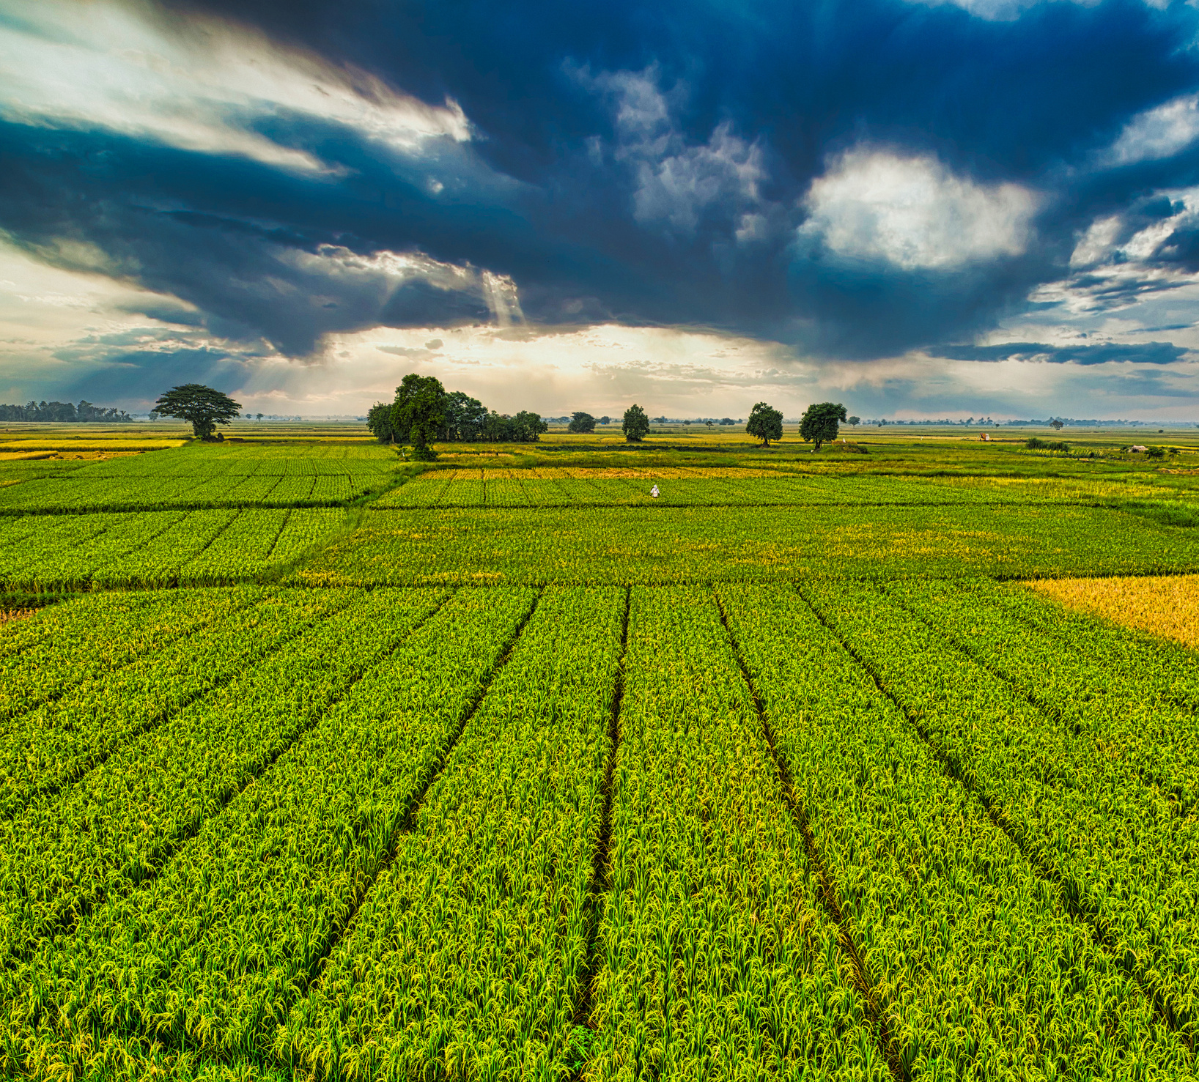
Data Overview
File Information
File Info: Crop Production in India.
Country: India.
Timespan: 1997-2015.
File Source: The Ministry of Agriculture & Farmers Welfare, Government of India.
Quick Insights
Parameters: Year, State, District, Season, Crop, Area cultivated
Total Entries: 246901
Total Seasons: 6
Total states:33
Total District: 646
Key Performance Indicators
Total Production, Total area
(Top States, Top Districts)[Production]
Yearly crop production
Top 5 crop
Season wise production and cultivable area

Slide 6

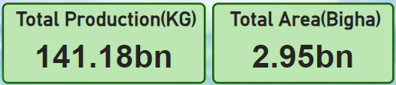
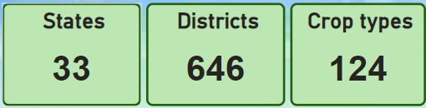
Analysis
General Overview
From 1997-2015, total production in 646 districts in 33 states were around 141.18 billion KG
Total of 124 types of crop were cultivated in 2.95 billion bigha of area.

Slide 7

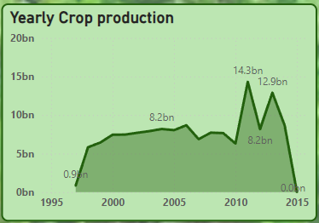
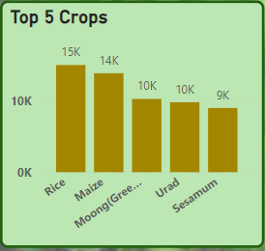
Analysis
The production of crop had a gradual increase from 1997 to 2006
from 0.9 billion to 8.2 billion. Sharp increase in production is seen after 2010s. Highest amount of production was in 2011 which accounted to 14.3 billion.
In India from 1997 to 2015 , the most grown crop is paddy or rice.
Maize and Moong holds the 2nd and 3rd position in this race. Othe
crops in the top 5 are urad and sesamum.

Slide 8

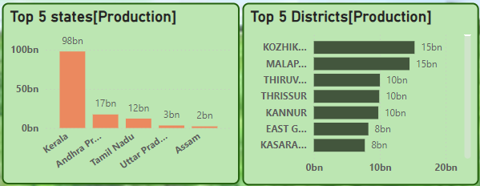
Analysis
Among the top 5 states in terms of production, Kerala holds the top postion with around 98billion Kg production in 15 years. Andhra Pradesh and Tamil Nadu holds the 2nd and 3rd position with around 17bn and 12bn kg respectively.
Among the districts, Kozhikode of Kerala holds the 1st place with around 15bn kg production. Other districts in the list are Malapuram, Thiruvananthpuram, Thrissur, Kannur, East godavari and Kasaragod

Slide 9

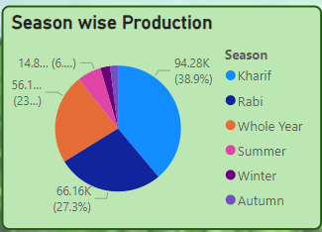
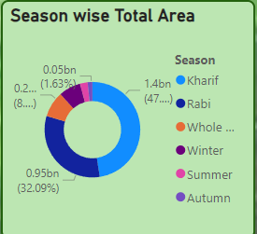
Analysis
In both terms of production and total area, Kharif season hold the top position with 38.9% and 47% share respectively. Rabi Crops and whole year stands on the 2nd and 3rd position repectively.

Slide 10
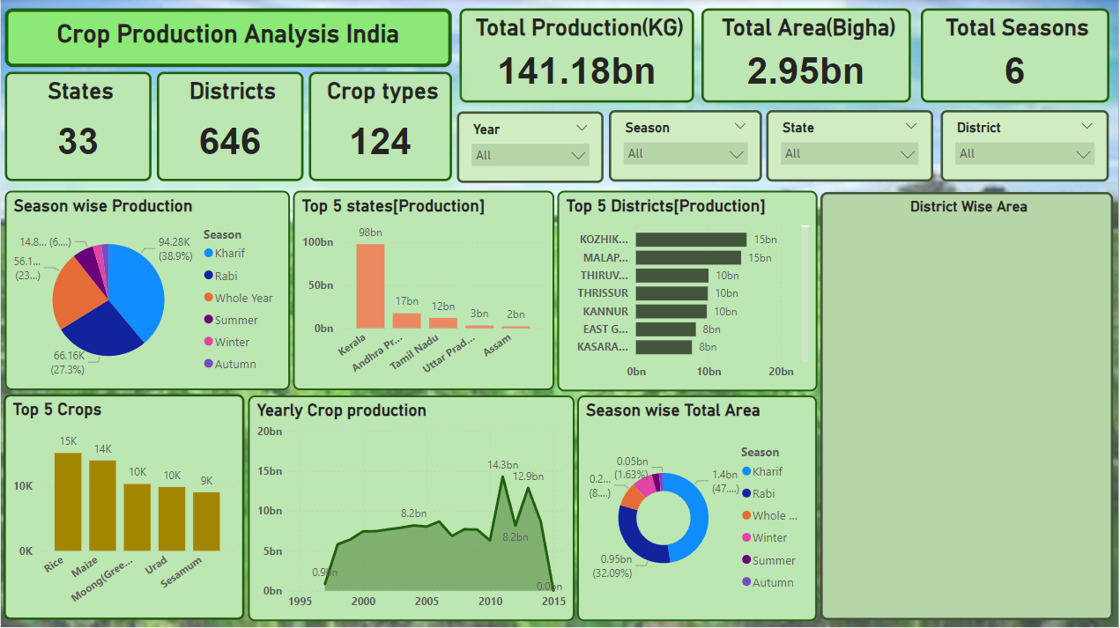
Dashboard

Slide 11

CONCLUSION
In conclusion, the crop analysis project in India highlights the nation's agricultural diversity and its pivotal role in the economy. By examining production trends, regional variations, and crop performance, the project provides valuable insights into areas for improvement and opportunities for growth. The findings emphasize the importance of adopting sustainable farming practices and modern technologies to enhance productivity and resilience against climate challenges. Such analysis supports informed decision-making and policy formulation, ultimately aiming to boost agricultural output and ensure food security. Continued focus on crop analysis will drive innovations and improvements in India's agriculture, benefiting farmers and the broader economy.

Slide 12
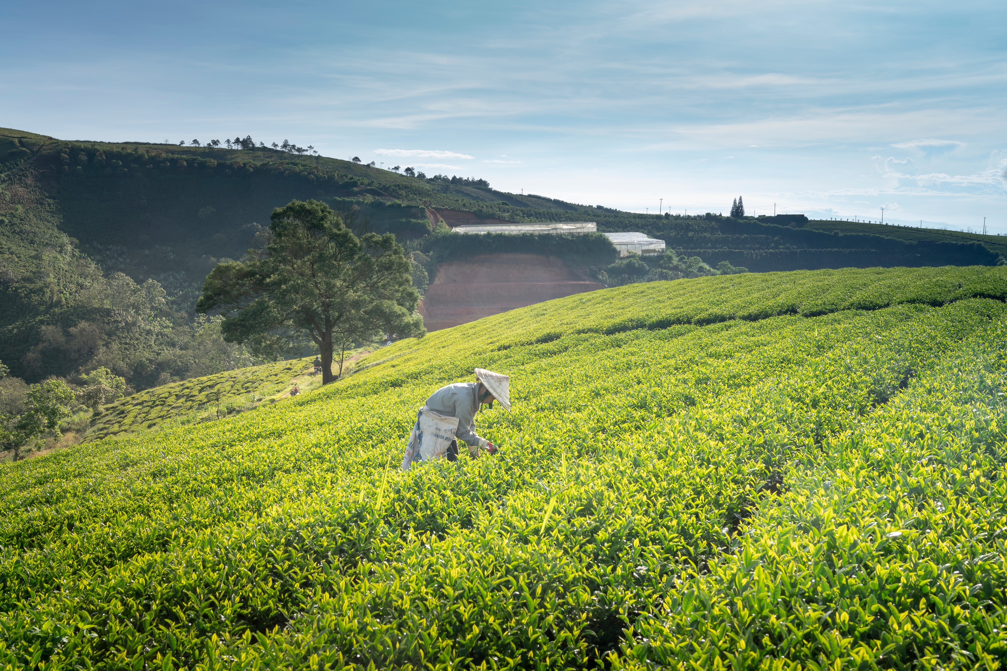




THANK YOU
DIPEAN DASGUPTA
+91 7778992530
dipeandasgupta@gmail.com
https://github.com/DipeanDas/UM_InternshipProjects/tree/main/Crop_Production_Analysis
Gandhinagar,Gujarat

